Slide 1
Kubernetes for Data Scientist/Engineers
Master Class
Srivatsan Srinivasan

Slide 2
Session Topics
Introduction to Containers and Kubernetes
Why Kubernetes?
Need of Modern Data Application
Hands on Demo
Flask Application Overview
Containerize Flask App
Create Kubernetes Cluster
Deploy Flask Application
Scale and Auto Scale Flask Application
Live Q&A

Slide 3
Introduction to Containers and Kubernetes

Slide 4
What is Kubernetes? (k8s)
Kubernetes is a open source platform for deploying and managing containers
Container packages up code and all its dependencies so the application runs quickly and reliably from one computing environment to another
Container image is a lightweight, standalone, executable package of software that includes everything needed to run an application: code, runtime, system tools, system libraries and settings
Container Engines take a Container Image and turn it into a Container
Container images become containers at runtime
Container Engines can be Docker, Linux Containers, rkt, CRI-O, Container-D etc

Slide 5
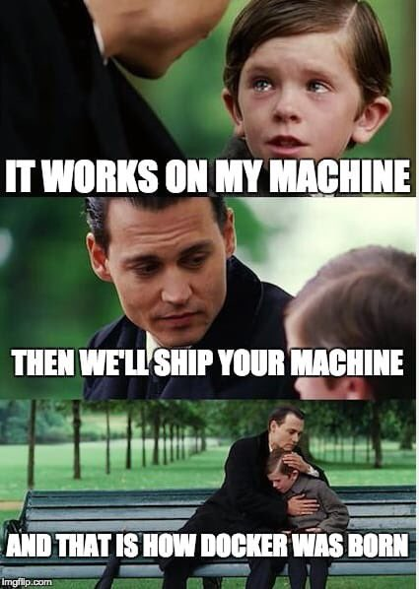

Slide 6
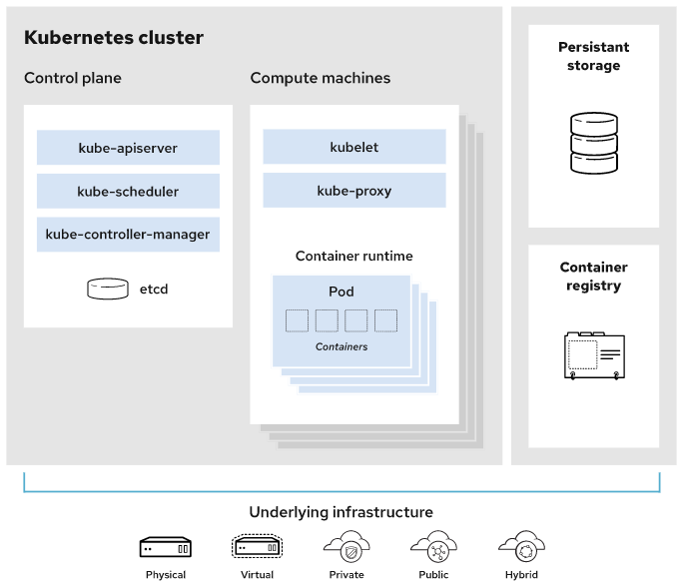
Kubernetes Architecture
Source: https://www.redhat.com/

Slide 7
Why do we need Kubernetes?
Platform to schedule and deploy containers on host of machines
Portable (Run anywhere)
Scale containers easily
Self Healing
Auto Scaling
Champion/Challenger deployment

Slide 8
Need of Modern Data Application

Slide 9
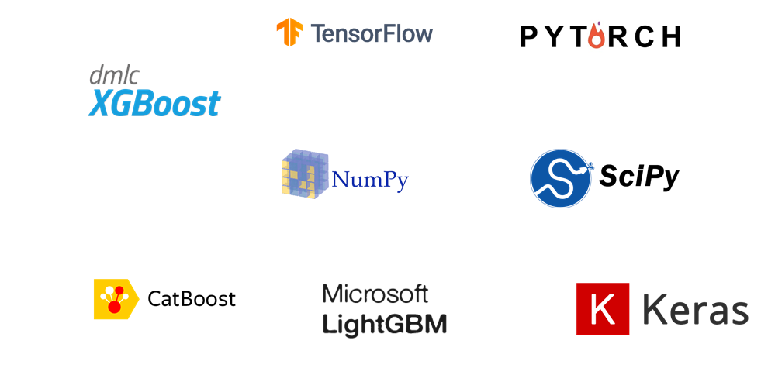
Dependency Management

Slide 10

Dependency Management
Data Scientist need access to latest and greatest version
Interdependency between multiple versions
Standalone machines/clusters does not provide way to isolate dependency easily

Slide 11
Solution
Containerization helps package software and dependencies. This guarantees software is isolated, self contained, reproducible and runs the same regardless of environment
Containerization

Slide 12
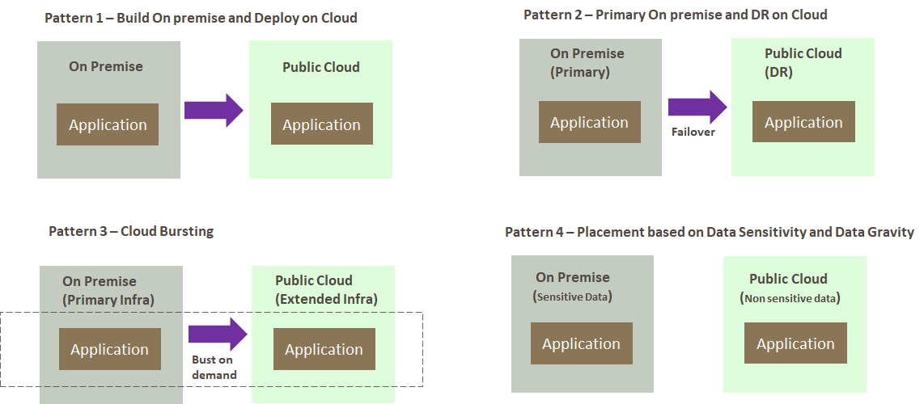
Hybrid Cloud

Slide 13
Solution
Kubernetes makes sure containerized applications run where, when and how you want
Kubernetes

Slide 14
Kubernetes In Action
Azure Cognitive Services containers - Bringing AI to Edge
Google Anthos - Run K8s anywhere
U.S military deployed K8s on F-16 fighter Jets
Heavy Data processing application like Spark provides native K8s support
Cassandra and some databases are K8s ready

Slide 15
Kubernetes In Action
Machine learning applications post training in many cases follow typical software engineer lifecycle
24/7 availability
Scale to sudden spikes
Zero downtime deployment
High Availability
A/B testing
Low Cost

Slide 16
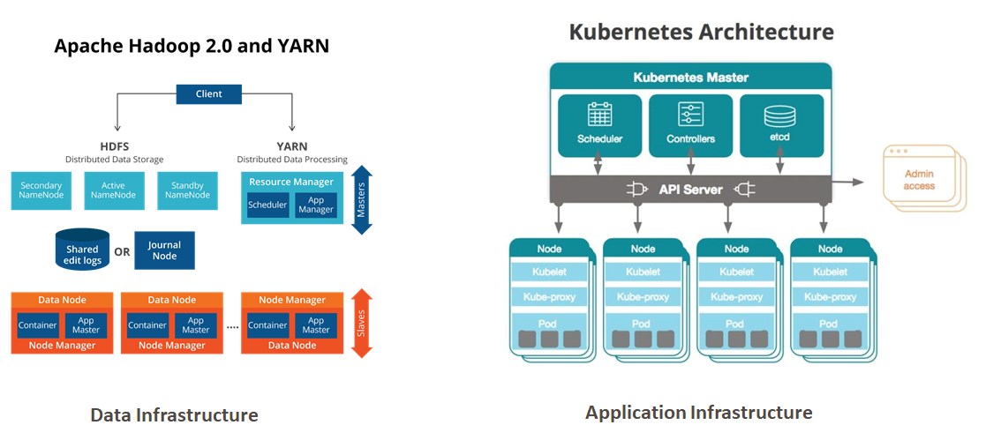
Separate Data and Application Infrastructure

Slide 17
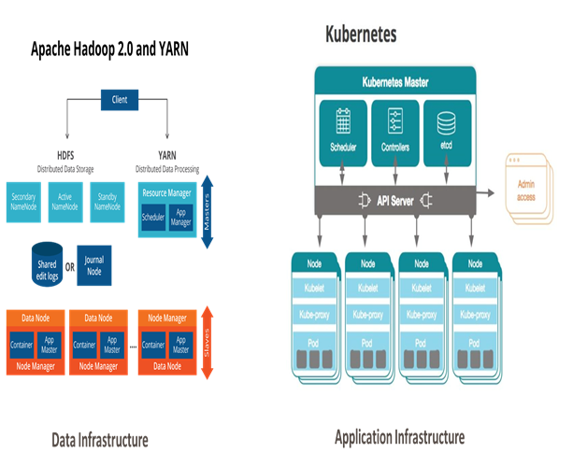
Separate Data and Application Infrastructure
Separate Infrastructure management
Separate Dev Ops/Data Ops
Not so efficient use of Infrastructure and Specialized hardware accelerators
Application have to re-written during movement from one environment to another

Slide 18
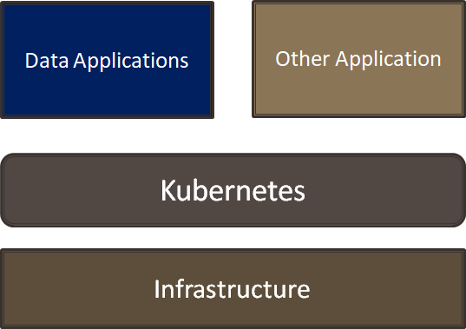
Solution
Converged Data Platform

Slide 19
Kubernetes Benefit
Common runtime layer across your private and public cloud
Abstract away dependency and version conflicts
Efficient usage of existing infrastructure
Consistent tooling and CI/CD process across environments to increase efficiency
Handle Bursty workload
Time to provision new environments and agility to test latest offering
Zero downtime upgrade

Slide 20
Demo - Background

Slide 21
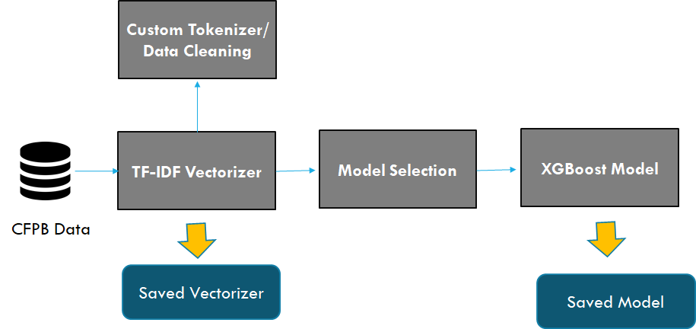
Model Details

